Slide 1

Computer Science ISP Explanation

Slide 2
Student List Code: Python
For my ISP I chose to make a list that displays student names and the courses they have.
I chose to do my ISP on python.

Slide 3
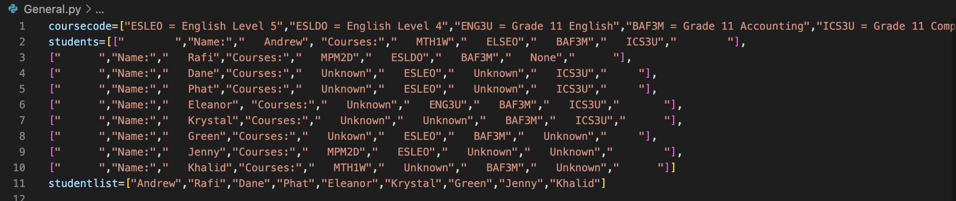
Let's take a look at the first part of the code
This first part is defining all of the lists that I will need to print in order for the list to actually work.
For the list labeled “students” i used a multidimensional list to allow me to print each student’s courses separately.
For the other lists I just used a normal list to define all of the student names and for the course codes.

Slide 4
The Second Part of the Code
In this part I use an infinite while loop so that the code can be used multiple times without running it again.
Then I determine that x is equal to an integer input between 1 and 9 or 0.

Slide 5
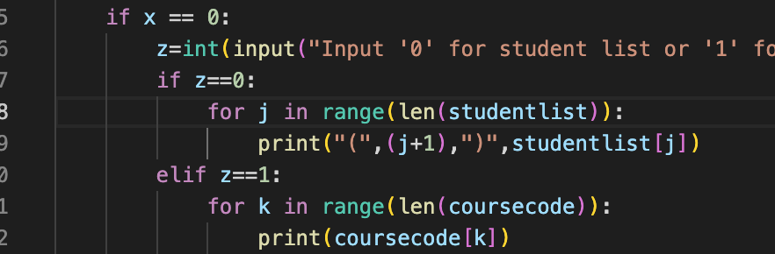
The Third Part of the Code
This is the first if statement that see’s whether the user’s input is 0 or not.
If the input is 0 it will determine another input ‘z’.
If z is 0 it will print the list of student names.
If z is 1 it will print the list of course codes.

Slide 6
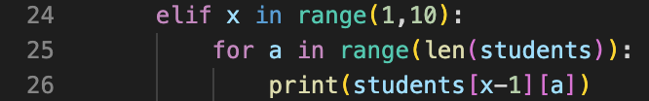
The Fourth Part of the Code
This part of the code is determining whether x is in between 1-9 (it says 1-10 but this is because when doing a range, it always minuses 1 from the second number).
If x is in between 1-9 it will then use a for loop for the length of the students list.
It will then define the variable ‘y’ equals 0 + a when a is whatever number the for loop is on.
It will then print x-1 and y inside the student list.

Slide 7
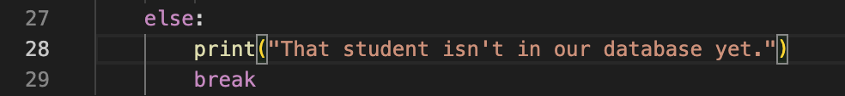
The Final Part of the Code
This is saying if none of the statements are true it will print “That student isn’t in our database yet.”, meaning the user either inputted an invalid input or they inputted a number not in between 1-9.
It will then break the while loop once it has printed that.

Slide 8
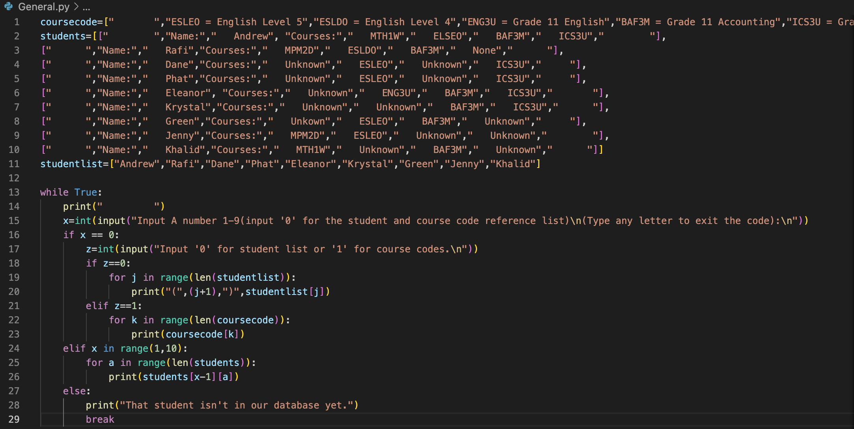
Entire Code:
Download .py file here

Slide 9
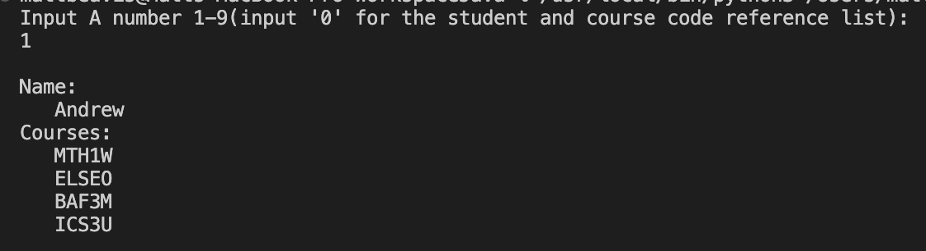
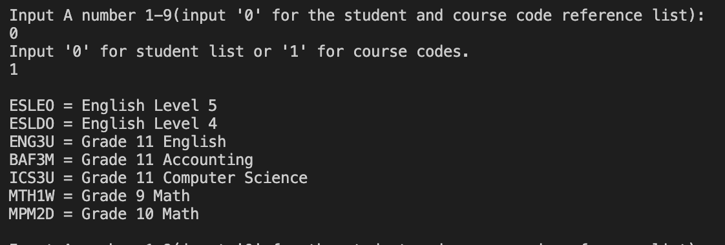
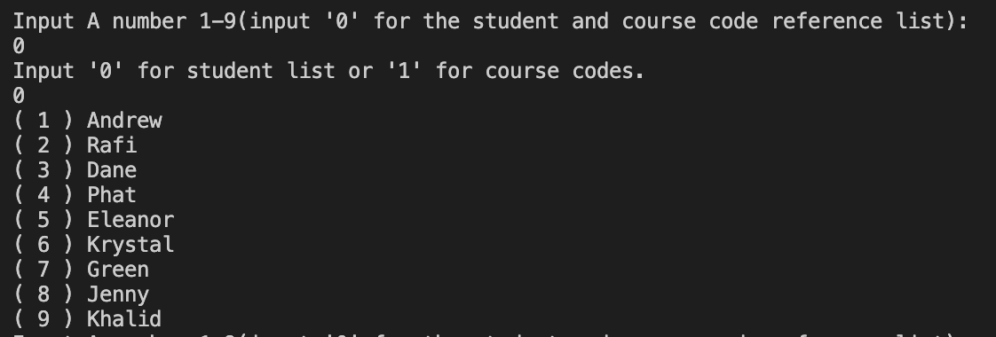
Outputs:
Choosing a Student:
Going to the Course Code Ref. List:
Going to Student Ref. List:
Inputting an invalid number:

Slide 10
Thank You For Listening

